Slide 1
CASCADING STYLE SHEET [CSS] Version 3

Slide 2
CSS DEVELOPMENT ENVIRONMENT
Visual Studio Code
VS Code Extension (CSS Peek, CSS Snippets, Colorize)
CSS Libraries / Components

Slide 3
CSS ARCHITECTURE
CSS architecture refers to the design patterns, naming conventions, and organization methods used to manage CSS code in a scalable and maintainable way.
Good CSS architecture helps manage the complexity and scope of styles as projects grow.

Slide 4
CSS ARCHITECTURE [Methodologies]
BEM (Block Element Modifier):
Block: A standalone entity that is meaningful on its own (e.g., .button).
Element: A part of a block that has no standalone meaning and is semantically tied to its block (e.g., .button__icon).
Modifier: A flag on a block or element that changes its appearance or behavior (e.g., .button--large).

Slide 5
CSS ARCHITECTURE [Methodologies]
Example: Applying BEM Methodology
/* Block: card */
.card {
background-color: white;
border-radius: 5px;
box-shadow: 0 2px 5px rgba(0, 0, 0, 0.1);
padding: 20px; margin: 20px 0;
}
/* Element: card__header */
.card__header {
font-size: 1.5em;
margin-bottom: 10px;
}
/* Modifier: card--featured */
.card--featured { border: 2px solid #007bff; }

Slide 6
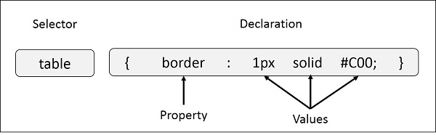
CSS SYNTAX
Selector − A selector is an HTML tag at which a style will be applied. This could be any tag like <h1> or <table> etc.
Property − A property is a type of attribute of HTML tag. Put simply, all the HTML attributes are converted into CSS properties. They could be color, border etc.
Value − Values are assigned to properties. For example, color property can have value either red or #F1F1F1 etc.
selector { property: value }

Slide 7
CSS Implementation
There are three ways to insert CSS in HTML documents.
Inline CSS
Internal CSS
External CSS
Inline CSS
Inline CSS is used to apply CSS on a single line or element.
For example:
<p style="color:blue">Hello CSS</p>
Internal CSS
Internal CSS is used to apply CSS on a single document or page. It can affect all the elements of the page. It is written inside the style tag within head section of html.
For example:
<style>
p{color:blue}
</style>

Slide 8
CSS Implementation
External CSS
External CSS is used to apply CSS on multiple pages or all pages. Here, we write all the CSS code in a css file. Its extension must be .css for example style.css.
For example:
p{color:blue}
You need to link this style.css file to your html pages like this:
<link rel="stylesheet" type="text/css" href="style.css">

Slide 9
CSS Selector
CSS selectors are used to select the content you want to style. Selectors are the part of CSS rule set. CSS selectors select HTML elements according to its id, class, type, attribute etc.
There are several different types of selectors in CSS.
CSS Element Selector
CSS Id Selector
CSS Class Selector
CSS Universal Selector
CSS Group Selector

Slide 10
CSS Selector
CSS Element Selector
The element selector selects the HTML element by name.
<!DOCTYPE html>
<html>
<head>
<style>
p{
text-align: center;
color: blue;
}
</style>
</head>
<body>
<p>This style will be applied on every paragraph.</p>
<p id="para1">Me too!</p>
<p>And me!</p>
</body>
</html>

Slide 11
CSS Selector
CSS ID Selector
The id selector selects the id attribute of an HTML element to select a specific element. An id is always unique within the page so it is chosen to select a single, unique element.
It is written with the hash character (#), followed by the id of the element.
<!DOCTYPE html>
<html>
<head>
<style>
#para1 {
text-align: center;
color: blue;
}
</style>
</head>
<body>
<p id="para1">Hello Javatpoint.com</p>
<p>This paragraph will not be affected.</p>
</body>
</html>

Slide 12
CSS Selector
CSS Class Selector
The class selector selects HTML elements with a specific class attribute. It is used with a period character . (full stop symbol) followed by the class name.
Note: A class name should not be started with a number.
<!DOCTYPE html>
<html>
<head>
<style>
.center {
text-align: center;
color: blue;
}
</style>
</head>
<body>
<h1 class="center">This heading is blue and center-aligned.</h1>
<p class="center">This paragraph is blue and center-aligned.</p>
</body>
</html>

Slide 13
CSS Selector
CSS Universal Selector
The universal selector is used as a wildcard character. It selects all the elements on the pages.
<!DOCTYPE html>
<html>
<head>
<style>
* {
color: green;
font-size: 20px;
}
</style>
</head>
<body>
<h2>This is heading</h2>
<p>This style will be applied on every paragraph.</p>
<p id="para1">Me too!</p>
<p>And me!</p>
</body>
</html>

Slide 14
CSS Selector
CSS Group Selector
The grouping selector is used to select all the elements with the same style definitions.
Grouping selector is used to minimize the code. Commas are used to separate each selector in grouping.
Let's see the full example of CSS group selector.
<!DOCTYPE html>
<html>
<head>
<style>
h1, h2, p {
text-align: center;
color: blue;
}
</style>
</head>
<body>
<h1>Hello Javatpoint.com</h1>
<h2>Hello Javatpoint.com (In smaller font)</h2>
<p>This is a paragraph.</p>
</body>
</html>

Slide 15
CSS Background
CSS background property is used to define the background effects on element. There are 5 CSS background properties that affects the HTML elements:
background-color
background-image
background-repeat
background-attachment
background-position
Background Color
body { background-color: #f0e68c; }
Background Image
body { background-image: url("images/tile.png"); }

Slide 16
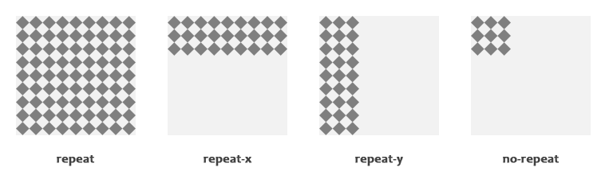
CSS Background
Background Repeat
body { background-image: url("images/gradient.png");
background-repeat: repeat-x; }
body { background-image: url("images/texture.png");
background-repeat: no-repeat; }

Slide 17
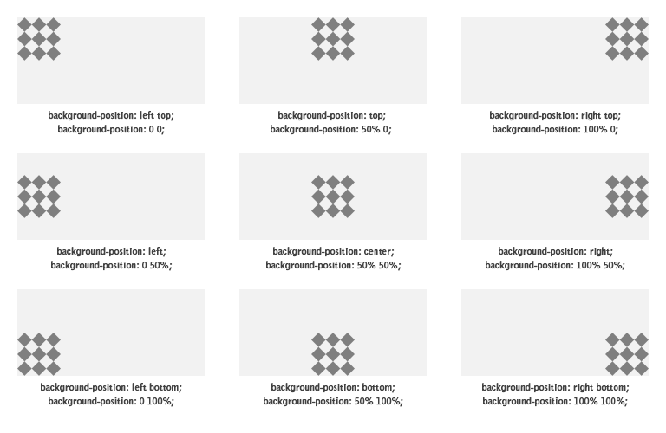
CSS Background
Background Position
body { background-image: url("images/robot.png");
background-repeat: no-repeat;
background-position: right top; }

Slide 18
CSS Background
Background Attachment
body { background-image: url("images/bell.png");
background-repeat: no-repeat;
background-attachment: fixed; }
The Background Shorthand Property
body { background-color: #f0e68c;
background-image: url("images/smiley.png");
background-repeat: no-repeat;
background-attachment: fixed;
background-position: 250px 25px; }

Slide 19
CSS Color
The color property defines the text color (foreground color in general) of an element.
body { color: #ff5722; }
Defining Color Values
Colors in CSS most often specified in the following formats:
a color keyword - like "red", "green", "blue", "transparent", etc.
a HEX value - like "#ff0000", "#00ff00", etc.
an RGB value - like "rgb(255, 0, 0)"

Slide 20
HTML [HYPER TEXT MARKUP LANGUAGE]
HTML Introduction
HTML Basics Tags
HTML Environment Setup
HTML Paragraph / Headings
HTML Images
HTML Lists
HTML Forms
HTML Tables
HTML Div Elements
HTML Block Elements
HTML Inline Elements

Slide 21
CSS 3 [CASECADING STYLE SHEET]
CSS Introduction & Basics
CSS Environment Setup
CSS Colors / Backgrounds
CSS Borders / Margins / Padding
CSS Text / Fonts
CSS Shadow / Positions
CSS Links
CSS Gridbox / Flexbox
CSS Forms / Buttons
CSS Responsiveness
CSS Pseudo Elements

